Slide 1

Ranking NCAA Football Teams Using Networks
Swetha Kallam

Slide 2
BACKGROUND
The NCAA Division I men’s basketball tournament is a single-elimination tournament of 68 teams that compete in seven rounds for the national championship.
PROBLEM
The current system involves a lot of strange metrics and some amount of arbitrary decisions by a committee and too many metrics which becomes over complicated
SOLUTION
To solve this problem, I would be using Networks and PageRank algorithm.
Additionally, the way conferences are set up in college sports, most of the best teams play together in groups. This means that different teams from different conferences will have drastically different levels of competition.
I would also use some common metrics.
This solution is based on a paper by James Kenner.
Notes:
https://epubs.siam.org/doi/abs/10.1137/1035004 – Link to research paper.

Slide 3

Methodology
The basic idea behind this method is that when team A beats team B. Team A receives a ‘vote’ from team B. How much is this vote worth? It depends on how many teams have voted for B (i.e., how many teams has B beaten).
If team B has beaten many teams which in turn have beaten many other teams, then this vote should be worth a lot. If team B has not beaten very many teams than this vote should not be worth very much.
This could be achieved using PageRank Algorithm.
B
Wins : 7
Losses: 2
Beats
A
Beats
C
Wins : 3
Losses: 8

Slide 4
Methodology – PageRank
PageRank is an algorithm named after Larry Page of Google and is used to determine the importance of webpages ranked in relation to all the other sites in a set.
It works by assigning a score to each webpage that is determined by the number of incoming links and the scores of those webpages which the incoming links come from.

Slide 5
Example
Imagine this simulated basketball season from 7 teams (a,b,c,d,e,f,g). There were 11 total games and they were not distributed equally among the teams.

Slide 6
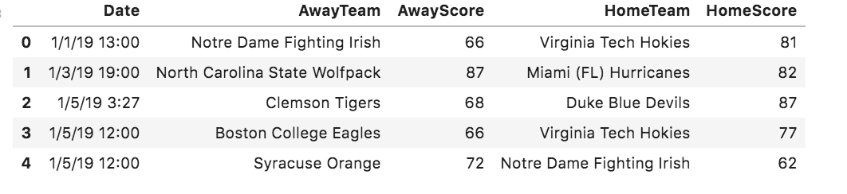
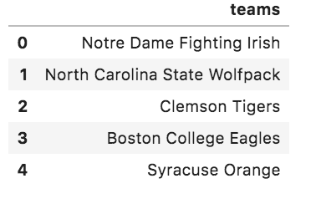
Data
Dataset 1: Away and home team scores
Dataset 2: Teams list
Data Source - https://www.espn.com/mens-college-basketball/standings

Slide 7
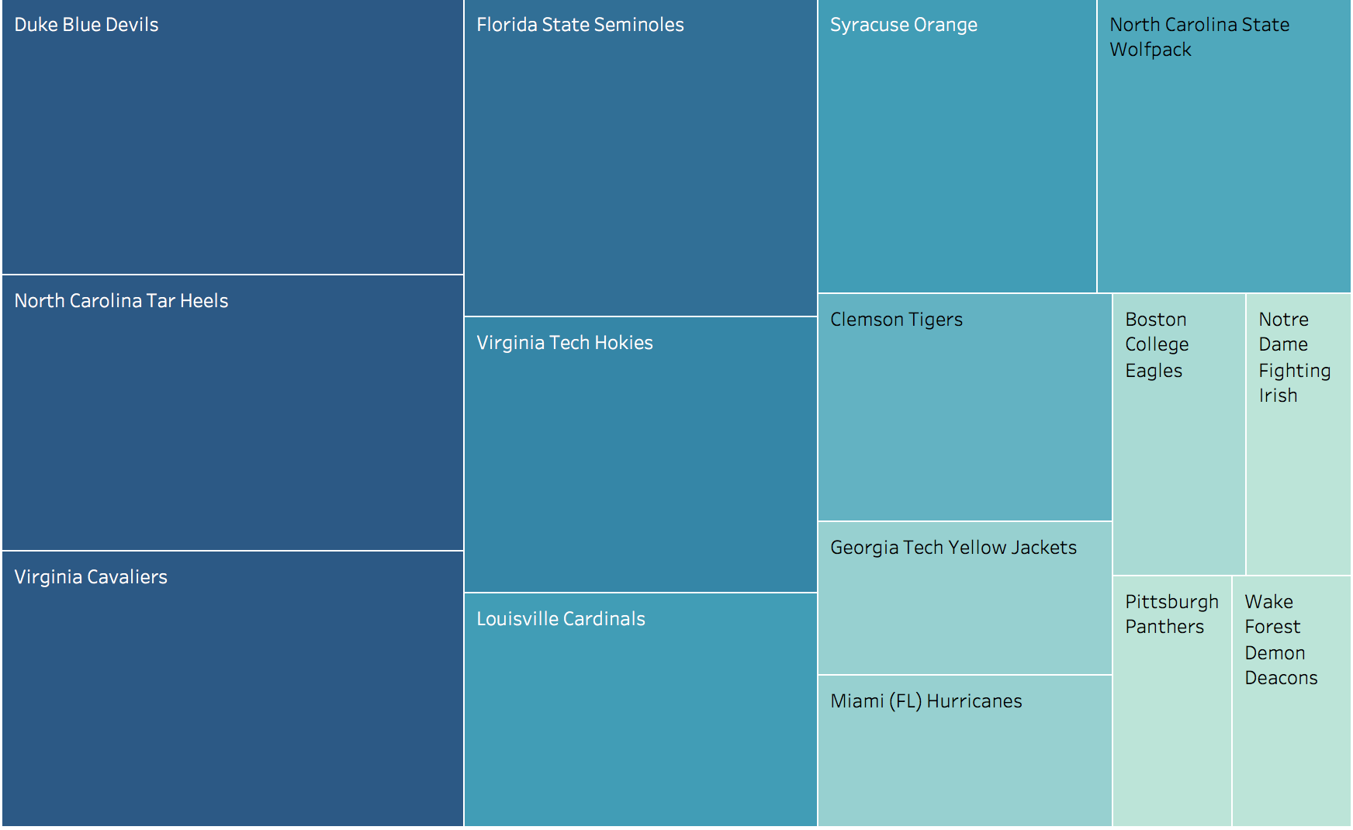
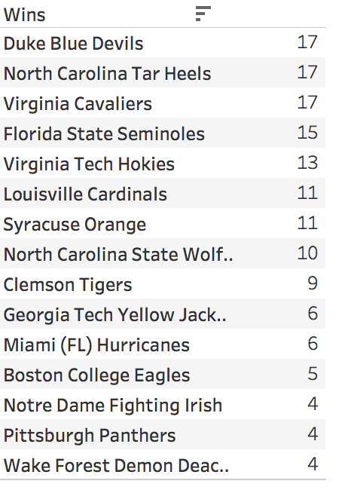
Exploring teams wins

Slide 8
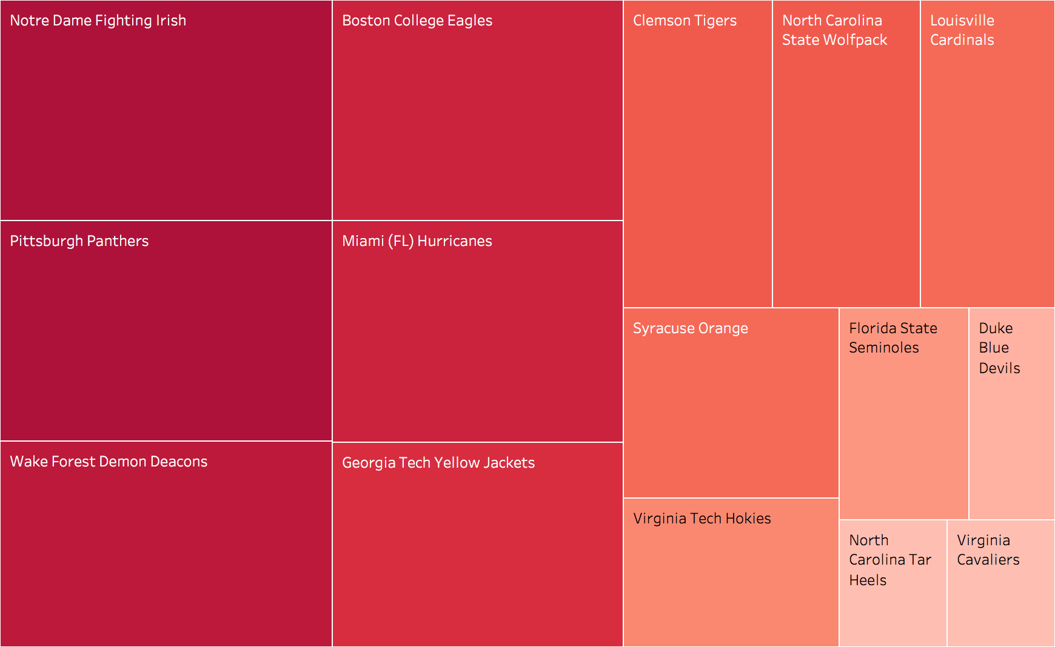
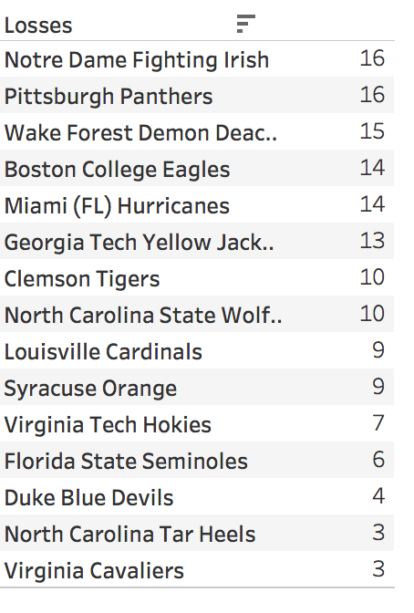
Exploring teams Losses

Slide 9
Implementation
Teams are represented using nodes.
Each individual game played is represented as an edge.
First step would be to convert the data into a matrix.
From this point on I used, NetworkX to build my graph and to get page rank scores.

Slide 10
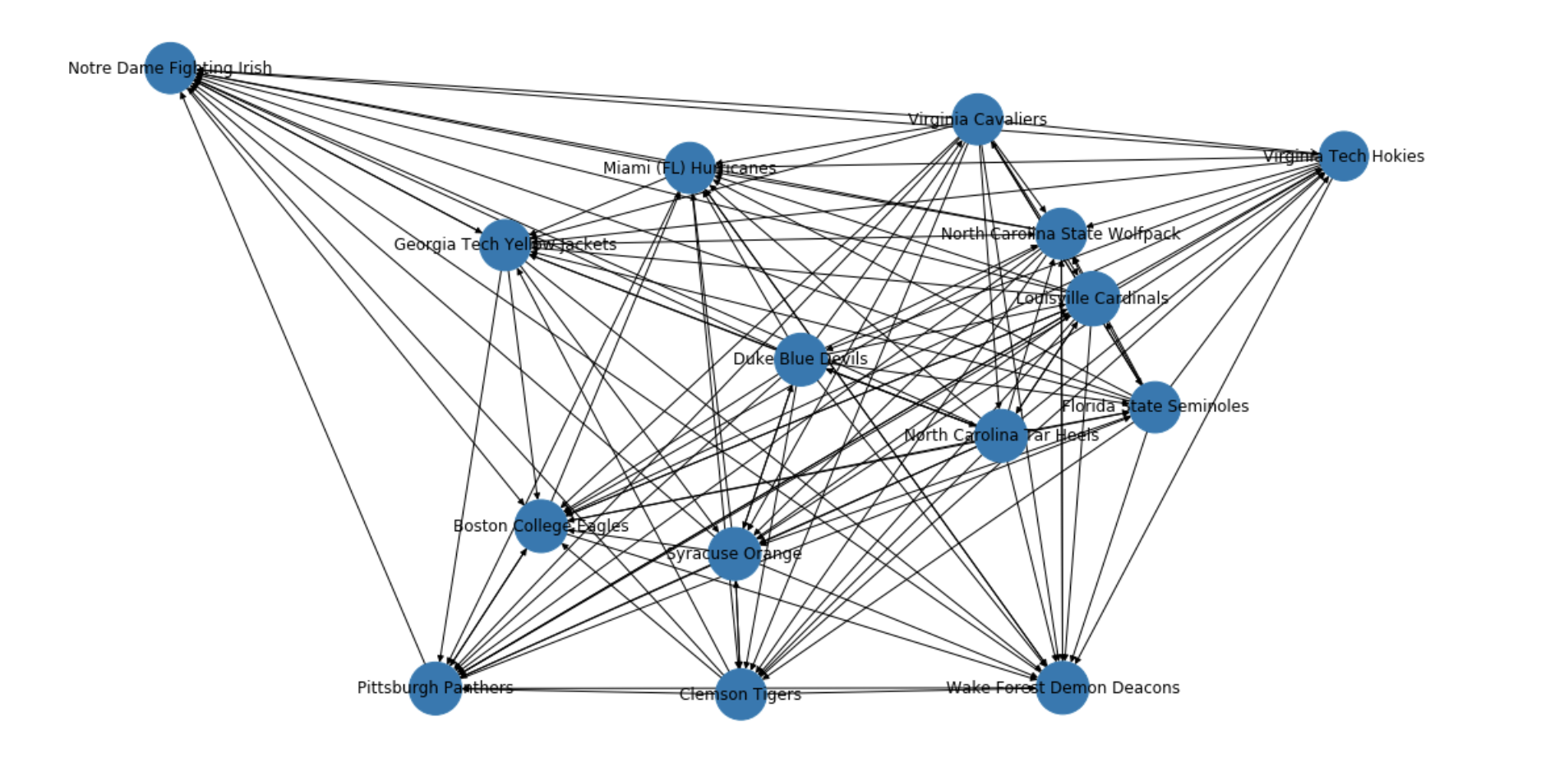
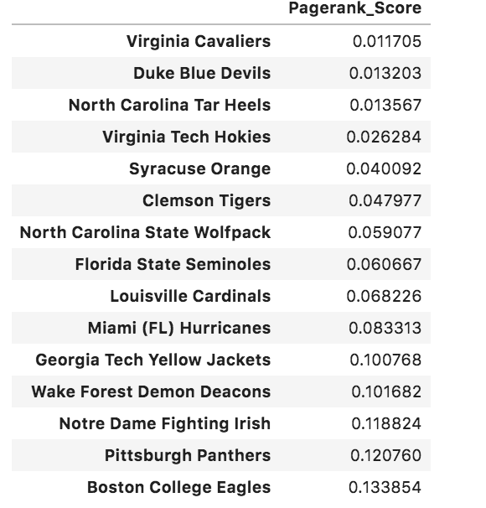
Outputs

Slide 11
Other Metrics
win/lose margin : When a team wins with a higher margin should matter much that with lower margin. It is calculated using
win/lose margin = homescore/(homescore + awayscore)
win rate : Win rate would determine how the team performed throughout the season. It was simple calculation:
win rate = total wins/ total games played

Slide 12
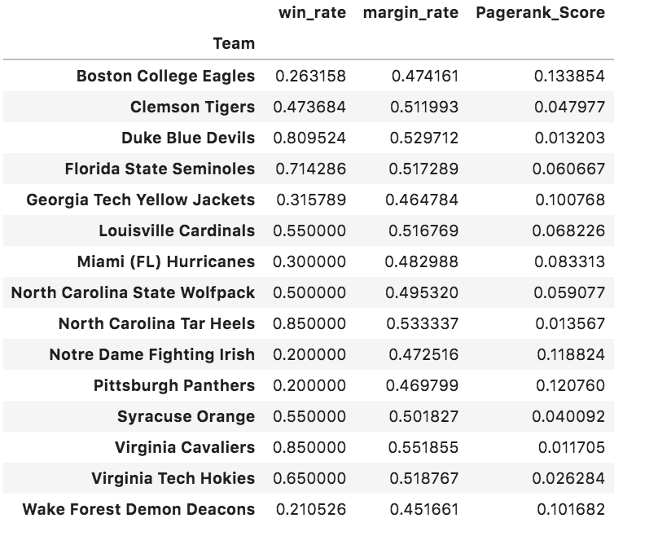
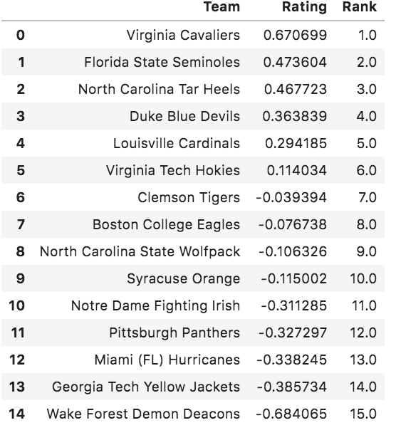
Final Rankings
Averaging all three metrics

Slide 13
Conclusion
I considered the teams over all performance in the season by calculating win rate
I factored in a team's performance in a match by taking margin rate
Even compared a team's performance throughout the season over other teams, by considering other teams' performance in the season.
This using networks, I could produce a fair ranking methodology.

